Slide 1
EPIPHYTE OBJECTIVES
Demonstrate room-scale open source Direct Air Capture (DAC)
Seed build for future Carbon Challenge iterations
Gather data for optimization of concept
Educational tool for students

Slide 2
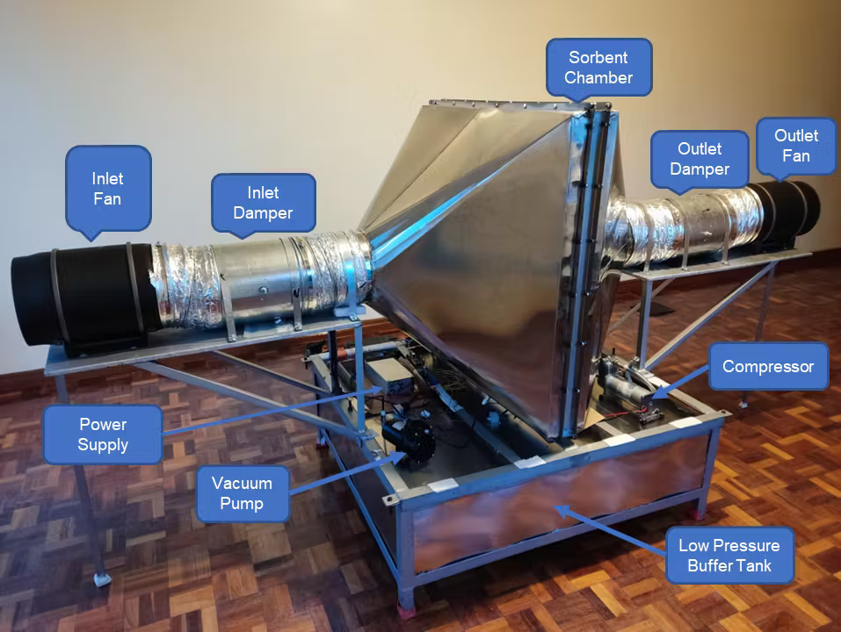
The Thursday DAC
Built by a team of eight over a period of four months

Slide 3
EPIPHYTE: SCALED DOWN “THURSDAY”
(EVENTUAL VISION)
FAN 1
DAMPER 1
DAMPER 2
FAN 2
SORBENT PANEL
Electrically Controlled Valves
SV1
SV4
VACUUM PUMP
CAPTURED CO2 TANK
SV3
SV2
EXIT

Slide 4
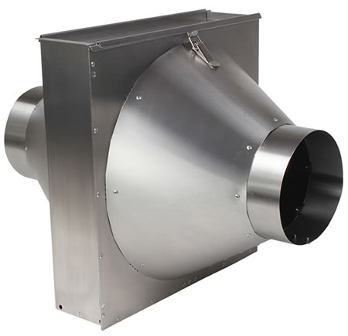
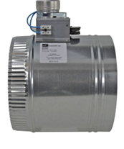
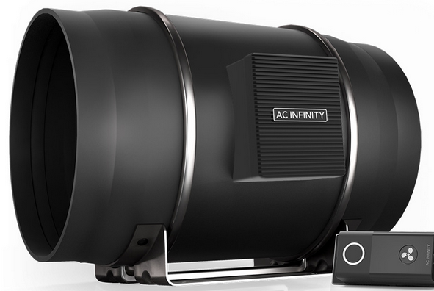

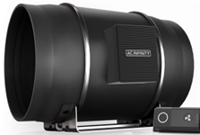
OFF-THE-SHELF COMPONENTS
FAN (x2)
DAMPER (x2)
HVAC FILTER BOX

Slide 5
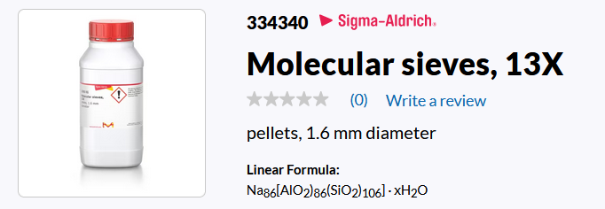
SORBENT
We will start with a Zeolite sorbent
Adsorbs CO2 at room temperature and pressure
Releases CO2 when heated or in a vacuum
Later we’ll experiment with different sorbents

Slide 6
COMPLETED EPIPHYTE CO2 CAPTURE SEQUENCE:
(1) ADSORPTION
FAN 1
DAMP 1
DAMP 2
FAN 2
SORBENT PANEL
ON
OPEN
OPEN
ON
HEATER OFF
AIR IS BLOWN THROUGH
CO2 IS CAPTURED BY SORBENT
SV1
SV4
VAC PUMP
CAPTURED CO2 TANK
OFF
SV3
SV2
EXIT

Slide 7
(2) SORBENT CHAMBER EVACUATION
FAN 1
DAMPER 1
DAMPER 2
FAN 2
SORBENT PANEL
OFF
CLOSED
CLOSED
OFF
HEATER OFF
AIR IS PUMPED OUT OF SORBENT CHAMBER AND TANK
SV1
SV4
VAC PUMP
CAPTURED CO2 TANK
ON
SV3
SV2
EXIT

Slide 8
(3) DESORPTION
FAN 1
DAMPER 1
DAMPER 2
FAN 2
SORBENT PANEL
OFF
CLOSED
CLOSED
OFF
HEATER ON
HEAT AND VACUUM CAUSE SORBENT TO RELEASE STORED CO2
SV1
SV4
VAC PUMP
CAPTURED CO2 TANK
OFF
SV3
SV2
EXIT

Slide 9
SORBENT HEATER CONFIGURATION
+
POWER SUPPLY
-
Standard Wire
(Insulated)
Heater (Resistive) Wire
(Insulated)
Sorbent
Heater wires are in thermal contact with mesh on both faces of the panel.
Inside or outside of mesh? TBD
Metal Frame
8 in
11 in

Slide 10
(4) CO2 EXTRACTION
FAN 1
DAMPER 1
DAMPER 2
FAN 2
SORBENT PANEL
OFF
CLOSED
CLOSED
OFF
HEATER ON
CO2 IS PUMPED OUT OF CHAMBER FOR STORAGE OR USE
TANK IS REPLACED
SV1
SV4
VAC PUMP
CAPTURED CO2 TANK
ON
SV3
SV2
EXIT
➔ CYCLE REPEATS….

Slide 11
EPIPHYTE 1.0 BUILD SEQUENCE
PHASE I: “HELLO WORLD!”
HELLO WORLD!
C
C
FAN 1
DAMPER 1
DAMPER 2
FAN 2
F
F
SENSORS:
C
CO2, HUMIDITY, AND TEMP
SORBENT PANEL
F
AIR FLOW
DO WE HAVE LESS CO2 GOING OUT THAN COMING IN??

Slide 12
EPIPHYTE 1.0 PHASE II:
TURN ON HEATER
DO WE HAVE HEAT?
CAN WE RELEASE CO2 FROM SORBENT?
T
T
C
C
FAN 1
DAMPER 1
DAMPER 2
FAN 2
T
T
HEATER
T
T
F
F
P
HEATER
SV1
T
T
SENSORS:
T
TEMPERATURE
EXIT
PRESSURE
P
C
CO2, HUMIDITY, AND TEMP
F
AIR FLOW

Slide 13
EPIPHYTE 1.0 PHASE III:
ADD VACUUM
T
T
C
C
FAN 1
DAMPER 1
DAMPER 2
FAN 2
T
T
T
T
F
F
P
HOW MUCH VACUUM CAN WE ACHIEVE?
T
T
SV1
SENSORS:
VACUUM PUMP
T
TEMPERATURE
P
PRESSURE
SV3
CO2, HUMIDITY, AND TEMP
EXIT
C
C
F
AIR FLOW

Slide 14
EPIPHYTE 1.0 FINAL DESIGN:
FULL AUTO CAPTURE CYCLE
T
T
C
C
FAN 1
DAMPER 1
DAMPER 2
FAN 2
T
T
T
T
F
F
P
MICROCONTROLLER
Control pumps, fans, valves
Read sensors
Run algorithm
Gather data
T
T
SV1
SV4
CO2 CAPTURE TANK
SENSORS:
VAC PUMP
T
TEMPERATURE
P
PRESSURE
SV3
SV2
CO2, HUMIDITY, AND TEMP
EXIT
P
C
C
F
AIR FLOW

Slide 15
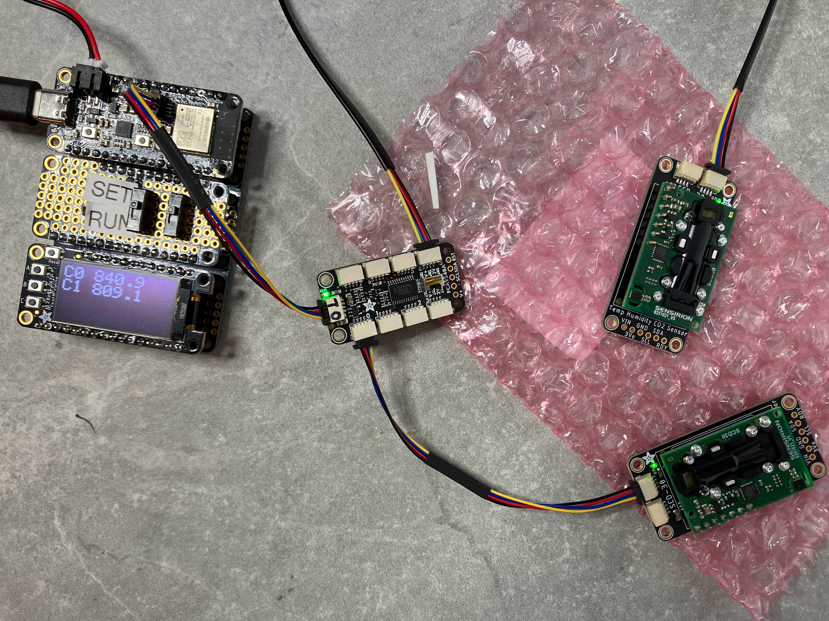
Epiphyte Electronics (Partial)
ESP32 FEATHER (CONTROLLER)
DISPLAY
I2C MUX
CO2 SENSORS

Slide 16
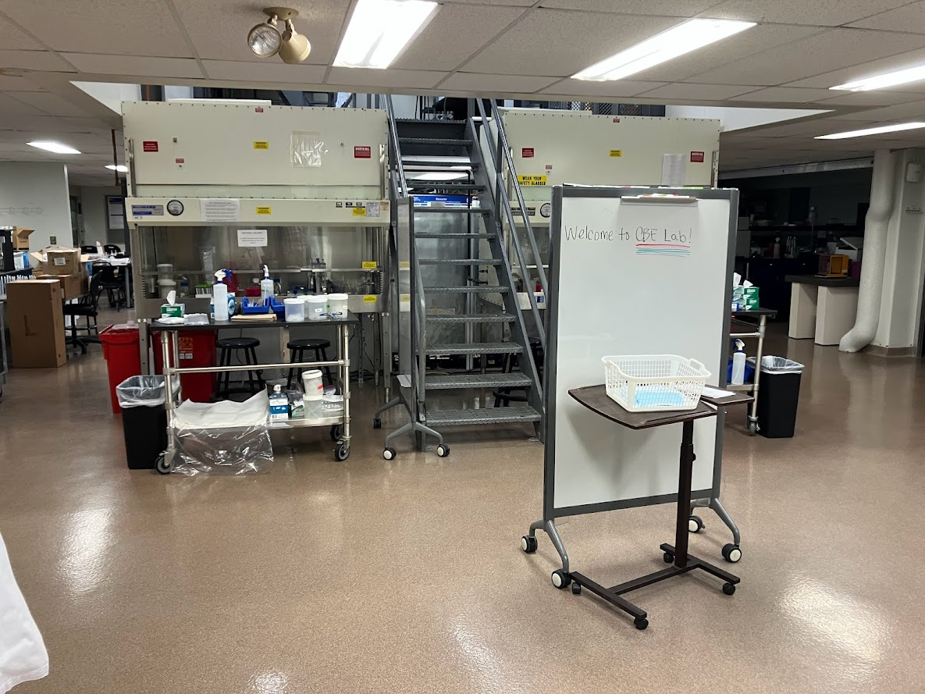
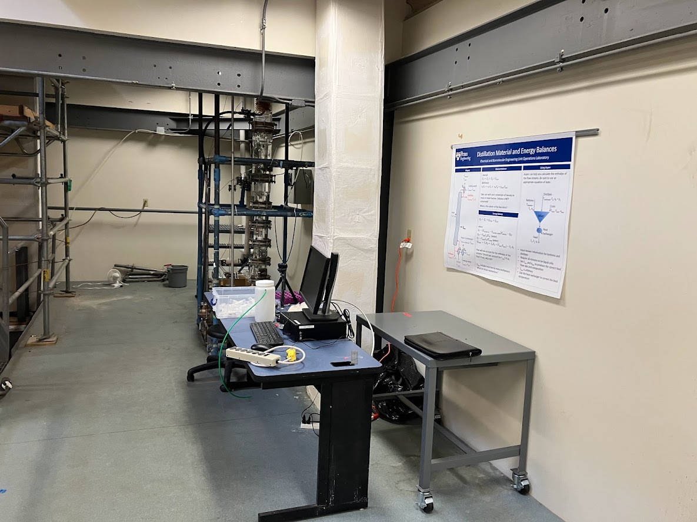
The Epiphyte Lab

Slide 17
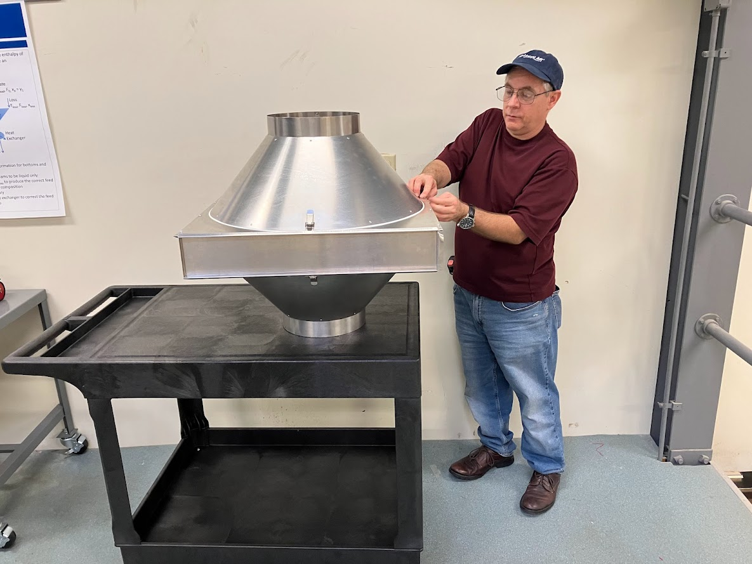
Assembly Begins!

Slide 18
